Slide 1
Autonomous Car Simulation using Machine Learning
Submitted in the partial fulfillment for the award of the degree of
BACHELOR OF ENGINEERING
IN
Artificial Intelligence and Machine Learning
Submitted by:
Syed.Fakruddin 21BCS6927
Aadi Shankar 21BCS8261
Dinesh Kumar 21BCS10635
Puneeth 21BCS10566
Under the Supervision of:
Mr. Prabhjot Singh Bali
Department of AIT-CSE
DISCOVER . LEARN . EMPOWER

Slide 2
Outline
Introduction to Project
Problem Formulation
Objectives of the work
Preliminary Design of the Project
Analysis of the Features Used in the Project
Methodology used
Results and Outputs
Conclusion
Future Scope
References

Slide 3
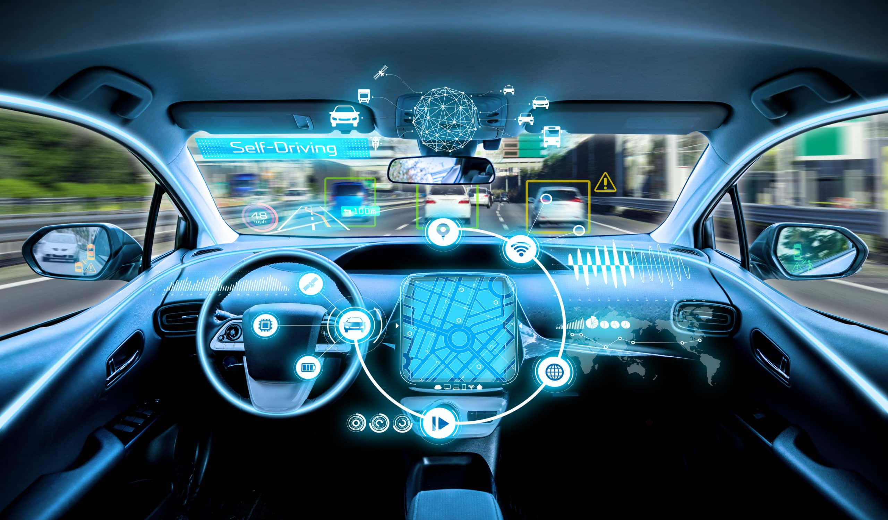
Problem Formulation
Define the overarching problem you want to solve in the context of autonomous car simulation with machine learning.
Safety Improvement:
Autonomous vehicles have the potential to significantly enhance road safety by lowering the number of accidents caused by human error.
Complex driving scenarios:
Machine learning enables self-driving cars to navigate complex and dynamic driving environments.
Adaptability to Environmental Change:
Autonomous cars use machine learning models to adapt to changing environmental conditions such as weather, lighting, and road infrastructure.

Slide 4
Introduction to Project
Autonomous vehicles, also known as self-driving or driverless vehicles, are a game-changing innovation in the automotive industry. The concept entails creating vehicles that can navigate and operate without human intervention.
Sensors & Perception:Autonomous vehicles use a variety of sensors to perceive and understand their surroundings, including lidar, radar, cameras, and ultrasonic sensors.
These sensors collect data to generate a real-time map of the surroundings, identifying objects, pedestrians, other vehicles, and road conditions.
Decision-making algorithms:
Self-driving cars make decisions using advanced algorithms and artificial intelligence. These algorithms interpret sensor data, assess the situation, and make appropriate decisions.

Slide 5
Objectives of the Work
Data generation and sensor integration:
Include a variety of sensors in the simulation environment, such as cameras, radar, and lidar.
Making decisions and planning a path:
Execute and evaluate machine learning algorithms for route planning and judgment.
Accurate Dynamics of Vehicles:
To effectively mimic the behavior of an autonomous vehicle, simulate realistic vehicle dynamics, such as steering, braking, and acceleration.
Efficiency and Scalability:
Make sure the machine learning models and simulation environment are effective and scalable so that various scenarios can be tested quickly and affordably.

Slide 6
Preliminary Design of the Project
The autonomous car simulation project consists of several key components that work together to enable the car to navigate and make decisions in a simulated environment.
Perception
Planning
Control
Simulation Environment

Slide 7
Analysis of the Features Used in the Project
Ultrasonic Sensor
short-range object detection.
CAN Bus
Real-time data sharing and control.
Radar
Detect objects and measure their speed.
Lidar Sensor
Detailed 3D map of the environment.
IMU
Acceleration, angular velocity, and orientation.

Slide 8
Methodology used
Defining the Issue and Establishing Objectives:
Clearly state the goals of the simulation, such as evaluating particular functions of autonomous driving (such as object detection and path planning).
Data Collection and Preprocessing:
Collect pertinent data so that the machine learning models can be tested and trained.
Simulation of Sensors and Actuators:
For the purpose of providing machine learning models with realistic input, simulate the behavior of sensors (cameras, radar, and lidar).
Testing and Validation:
Verify how well the machine learning models function in the simulation setting. Evaluate their generalizability to various scenarios, accuracy, and dependability.

Slide 9
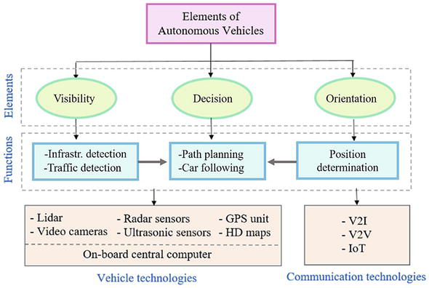

Slide 10
Results and Outputs
Analysis of Behavior:
An examination of the way the simulated autonomous car behaves in a range of situations, including how well it handles obstacles, adjusts to changing road conditions, and engages with other simulated cars and pedestrians.
Analysis of Failure:
Identification and examination of edge cases or failure scenarios where the autonomous vehicle might not operate at its best. This is essential for comprehending constraints and improving the system.
System Sturdiness:
Evaluating the autonomous system's resilience by subjecting it to perturbations, noise from sensors, or artificial errors to see how well it bounces back and adjusts.

Slide 11
Conclusion
Improved Sensation and Intuition:
The use of machine learning algorithms in autonomous vehicles makes it possible for them to recognize and categorize objects in their environment with high accuracy.
Examining robustness and analyzing edge cases:
Robustness testing is made easier by the simulation process, which introduces a variety of scenarios, including edge cases and unexpected events.
Getting Ready for Real-World Implementation:
An essential step before autonomous car deployment in the real world is the simulation process. Developers can enhance the safety, dependability, and flexibility of the autonomous system in a variety of on-road scenarios by tackling problems in a controlled setting.
In conclusion, the field of machine learning simulation of autonomous vehicles is dynamic and developing and has enormous potential to transform transportation.

Slide 12
Future Scope
Onboard processing and edge computing:
Real-time processing of sensor data by autonomous vehicles will be made possible by the integration of edge computing and powerful onboard processing capabilities.
Networked and Collaborative Self-governing Systems:
Vehicle-to-vehicle (V2V) and vehicle-to-infrastructure (V2I) communication integration will make it possible for autonomous systems to work together and be networked.
Interaction of Humans and Autonomous Vehicles:
Improving human-autonomous vehicle interaction will be the main focus of future developments. This entails creating user-friendly interfaces, channels of communication, and tactics to foster mutual respect and understanding between passengers and autonomous vehicles.

Slide 13
References
Thrun, S., Burgard, W., & Fox, D. (2005). Probabilistic Robotics. MIT Press.
Krajzewicz, D., Erdmann, J., Behrisch, M., & Bieker, L. (2012). Recent development and applications of SUMO - Simulation of Urban MObility. International Journal On Advances in Systems and Measurements, 5(3&4), 128-138.
Chen, J., Dolan, J. M., Huppenkothen, D., & Lattner, D. (2015). A Survey of Autonomous Vehicle Simulation Platforms. arXiv preprint arXiv:1504.01967.
Codevilla, F., Miiller, M., López, A., Koltun, V., & Dosovitskiy, A. (2018). End-to-End Driving via Conditional Imitation Learning. In Proceedings of the IEEE International Conference on Robotics and Automation (ICRA).

Slide 14
Thank you

